Slide 1

FRONT-END
ENGINEERING
PROJECT
by- Akshat Aggarwal
2110990122
G5
3rd YEAR
Batch 2021
INSTRUCTORS’S NAME - MR. LAVISH ARORA

Slide 2
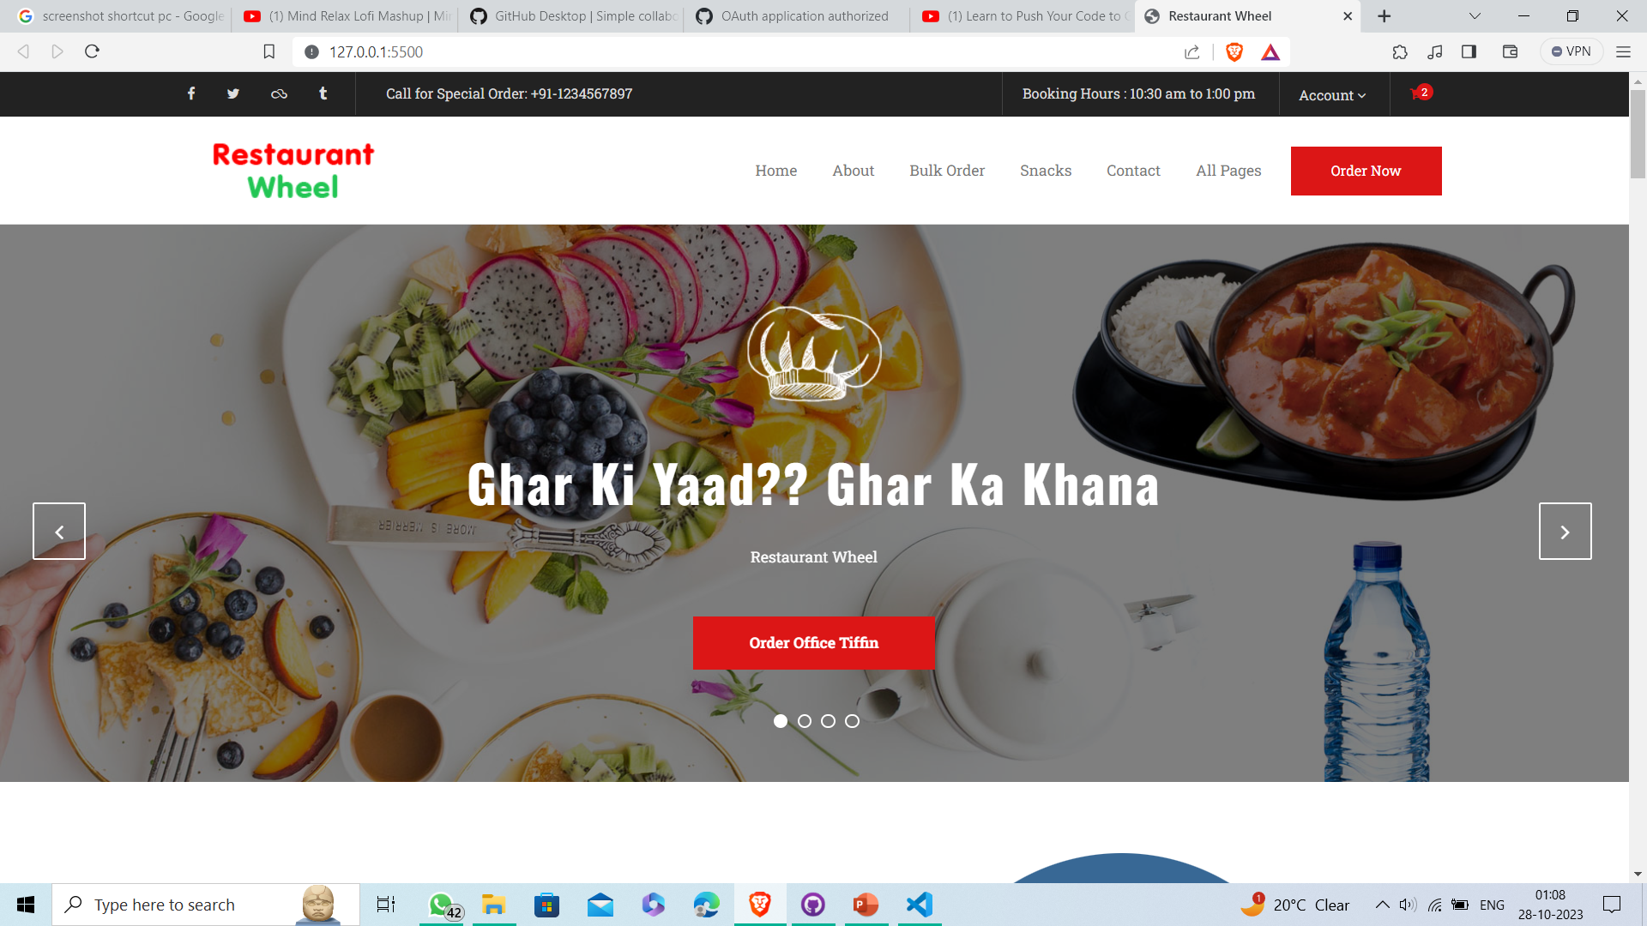
1
INTRODUCTION
The project is based on an E-COMMERCE website for selling Food online and deliver them to any part of the country. The title for the website is ”Restaurant Wheel”. It took around 30 days for me to complete the project. The website has around 30 pages, 14-15 out of which are entirely different and the rest are product based pages.
Restaurant Wheel

Slide 3
2
ORIGIN
The website is made with the idea that the youth of our country are fond of Chinese Food but these type of food aren’t easily available in Tier-2 and Tier-3 cities or rural areas . Even the Tier-1 cities face shortage of hygienic food many times and also don’t have much variety. So this website could be great experience for the buyers in buying products easily and at best prices.
Restaurant Wheel

Slide 4
3
PROBLEMS FACED
The most challenging parts of the website have been the header and the home page for me as I wanted to have the best design and structure possible, so I browsed the internet to search for different ideas and came up with a black and white theme which I think is simple but elegant.
First Problem
The header of the website is a very important thing but as beginer it was difficult to design and structure navigation panel
Restaurant Wheel
Second Problem
The home page also plays a very important role in website, its difficult to search for the best pictures of the products online and judging the best suitable size for the pictures

Slide 5

4
The page shown beside is the HOME PAGE of the website, you can see the Logo of the website which says “Restaurant Wheel” i.e also the title of the website. The website has been given a white and black theme. On the top the user can see the NAVIGATION PANEL i.e the header, which is helpful in browsing throughout different pages in the website.
Restaurant Wheel

Slide 6
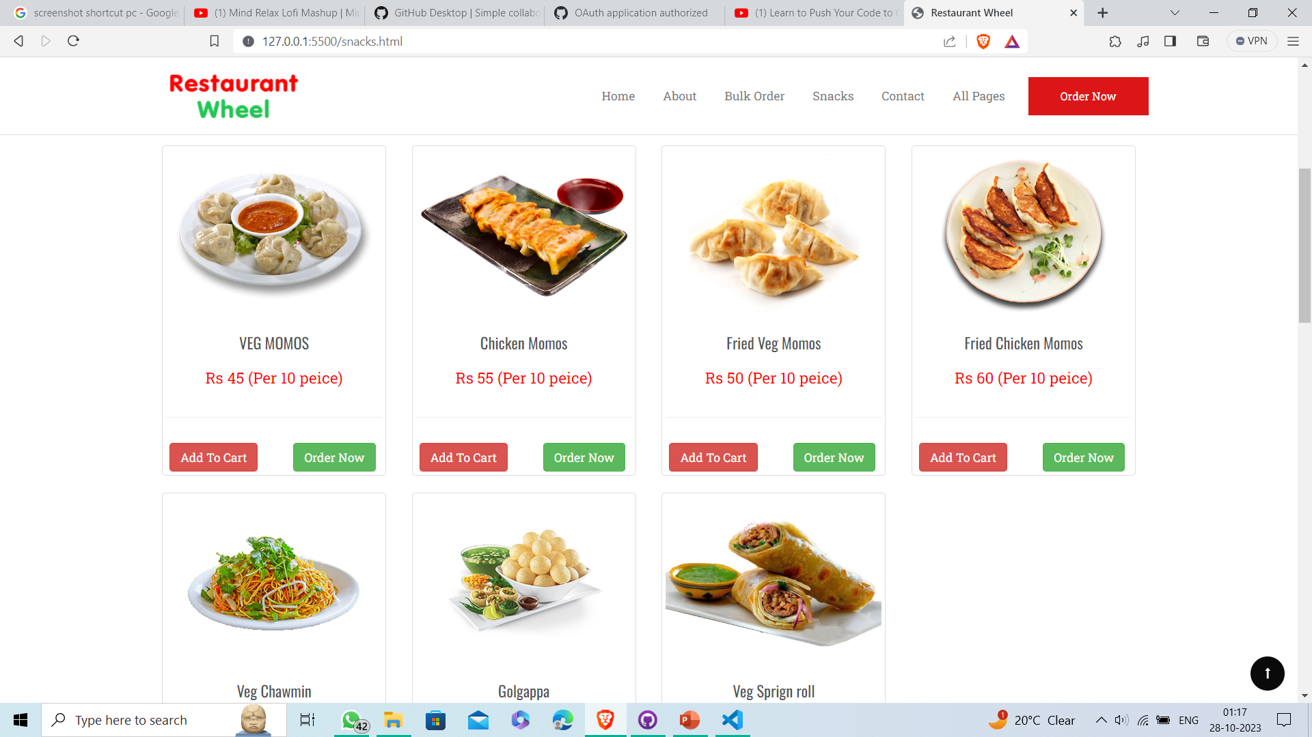
5
Then comes the SNACKS section of the Home page. Where products are hand picked by the experts on the basis of comfortability and durability.
Restaurant Wheel

Slide 7
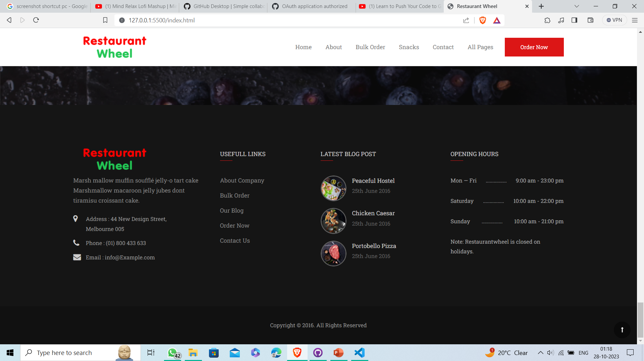
6
In the last we have the FOOTER of the website which consist of copyright notice, social media icons, option for subscribing to our newsletter through e-mail, link to terms and conditions, icons of payment options, etc.
Restaurant Wheel

Slide 8
THANK YOU
Presented By : Aarush Khanna

